Slide 1
Leitor Exibidor Java
Grupo 5
Gabriel Martins de Miranda - 130111350
Marina Martins de Miranda – 110132351
Victor Fernandes Uriarte - 110021193
Guilherme Neves Souza – 130113182
Elton Araujo de Castro - 110028384

Slide 2
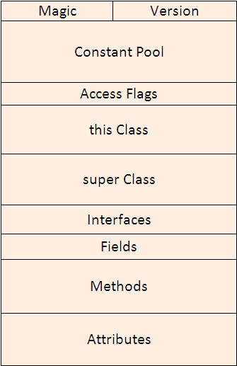
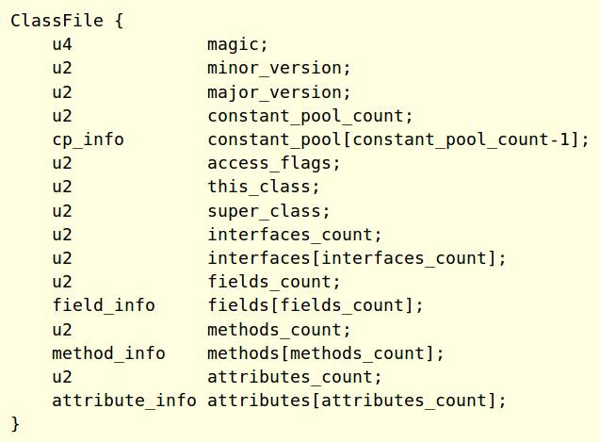
Java Class File structure

Slide 3
Java Class File structure
A Java class file is consist of 10 basic sections:
Magic Number: 0xCAFEBABE
Version of Class File Format: the minor and major versions of the class file
Constant Pool: Pool of constants for the class
Access Flags: for example whether the class is abstract, static, etc.
This Class: The name of the current class
Super Class: The name of the super class
Interfaces: Any interfaces in the class
Fields: Any fields in the class
Methods: Any methods in the class
Attributes: Any attributes of the class (for example the name of the sourcefile, etc.)

Slide 4
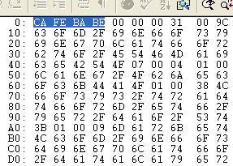
Magic number
Magic number is used to uniquely identify the format and to distinguish it from other formats.
The first four bytes of the Class file are 0xCAFEBABE.

Slide 5
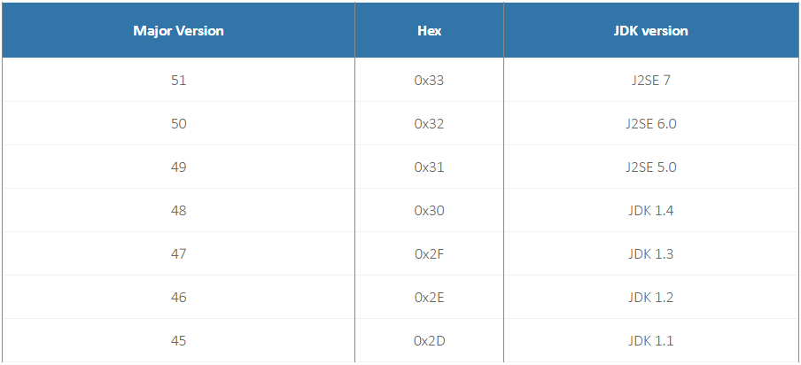
Version of Class file
The next four byte of the class file contains major and minor version numbers. This number allows the JVM to verify and identify the class file. If the number is greater than what JVM can load, the class file will be rejected with error java.lang.UnsupportedClassVersionError.

Slide 6
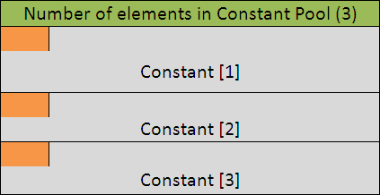
Constant Pool
All the constants related to the Class or an Interface will get stored in the Constant Pool.The constants includes class names, variable names, interface names, method names and signature, final variable values, string literals etc.

Slide 7
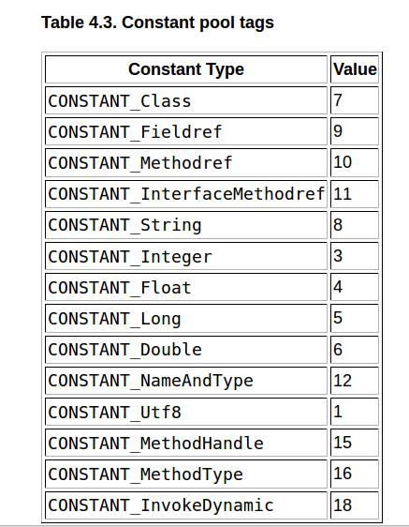
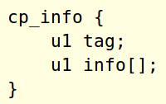
Constant Pool
Java Virtual Machine instructions do not
rely on the run-time layout of classes,
interfaces, class instances, or arrays.
Instead, instructions refer to symbolic
information in the constant_pool table.

Slide 8
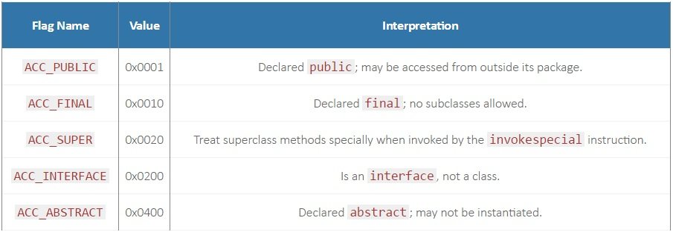
Access flags
Access flags follows the Constant Pool. It is a two byte entry that indicates whether the file defines a class or an interface, whether it is public or abstract or final in case it is a class. Below is a list of some of the access flags and their interpretation

Slide 9
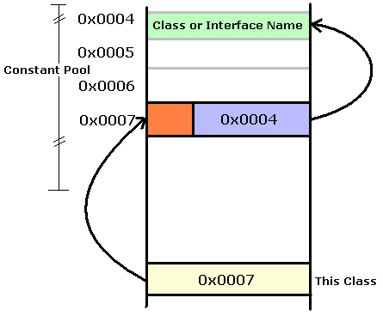
this Class
Access flags follows the Constant Pool. It is a two byte entry that indicates whether the file defines a class or an interface, whether it is public or abstract or final in case it is a class. Below is a list of some of the access flags and their interpretation.

Slide 10
super Class
Next 2 bytes after This Class is of Super Class. Similar to this class, value of two bytes is a pointer that points to Constant pool which has entry for super class of the class.

Slide 11
Interfaces
All the interfaces that are implemented by the class (or interface) defined in the file goes in Interface section of a class file. Starting two byte of the Interface section is the count that provides information about total number of interfaces being implemented. Immediately following is an array that contains one index into the constant pool for each interface implemented by class.

Slide 12
Fields
A field is an instance or a class level variable (property) of the class or interface. Fields section contains only those fields that are defined by the class or an interface of the file and not those fields which are inherited from the super class or super interface.
First two bytes in Fields section represents count: that is the total number of fields in Fields Section. Following the count is an array of variable length structure one for each field. Each element in this array represent one field. Some information is stored in this structure where as some information like name of the fields are stored in Constant pool.

Slide 13
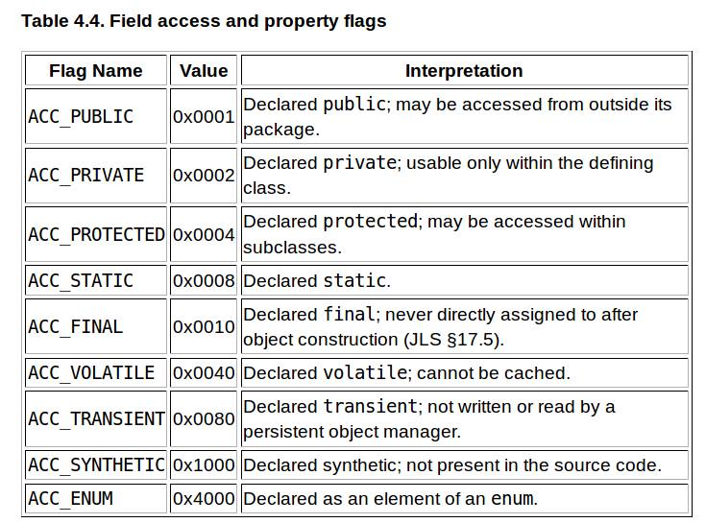
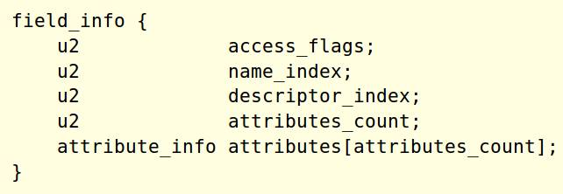
Fields

Slide 14
Methods
The Methods component host the methods that are explicitly defined by this class, not any other methods that may be inherited from super class.
First two byte is the count of the number of methods in the class or interface. The rest is again a variable length array which holds each method structure. Method structure contains several pieces of information about the method like method argument list, its return type, the number of stack words required for the method’s local variables, stack words required for method’s operand stack, a table for exceptions, byte code sequence etc.

Slide 15
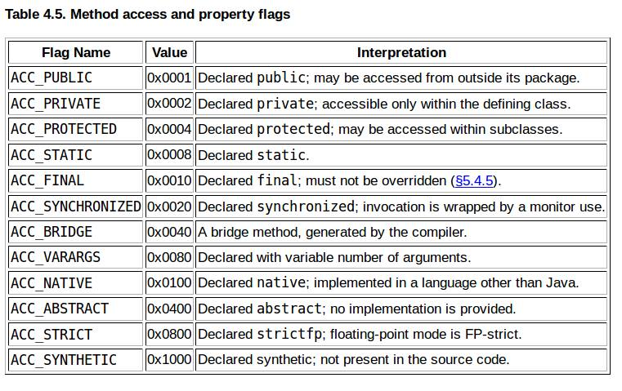
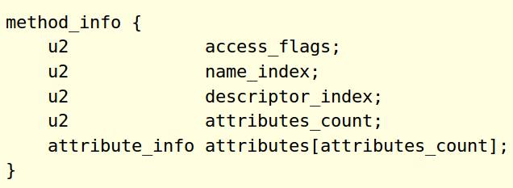
Methods

Slide 16
Attributes
Attribute section contains several attribute about the class file, e.g. one of the attribute is the source code attribute which reveals the name of the source file from which this class file was compiled.
First two bytes in Attribute section is count of the number of attributes, followed by the attributes themselves. The JVMs will ignore any attributes they don’t understand.
Let me know your comments and suggestions about this tutorial.

Slide 17
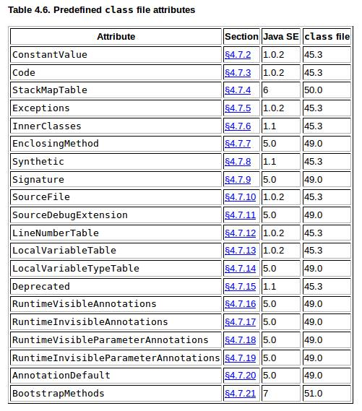
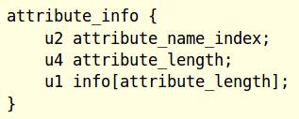
Attributes

Slide 18
Bibliografia
http://viralpatel.net/blogs/tutorial-java-class-file-format-revealed/
https://docs.oracle.com/javase/specs/jvms/se7/html/jvms-4.html
https://docs.oracle.com/javase/specs/jvms/se7/html/jvms-6.html

